Slide 1
Classification

Slide 2
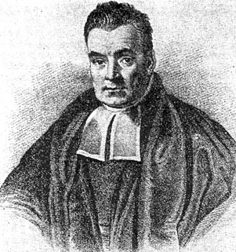
Bayes Rule
Bayes, Thomas (1763) An essay towards solving a problem in the doctrine of chances. Philosophical Transactions of the Royal Society of London, 53:370-418
Likelihood
Probability of D given h
Prior Probability of hypothesis h
Posterior Probability of h given D

Slide 3



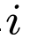
Naïve Bayes Classifier
Assume a target function with f: X→V, where each instance x is described by <x₁, x₂, …, x_{n}>. Most probable value of f(x) is:
Using the Naïve Bayes assumption:

Slide 4
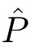
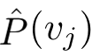

Notes of caution! (1)
Conditional independence is often violated
We don’t need the estimated posteriors to be correct, only need:
Usually, posteriors are close to 0 or 1

Slide 5
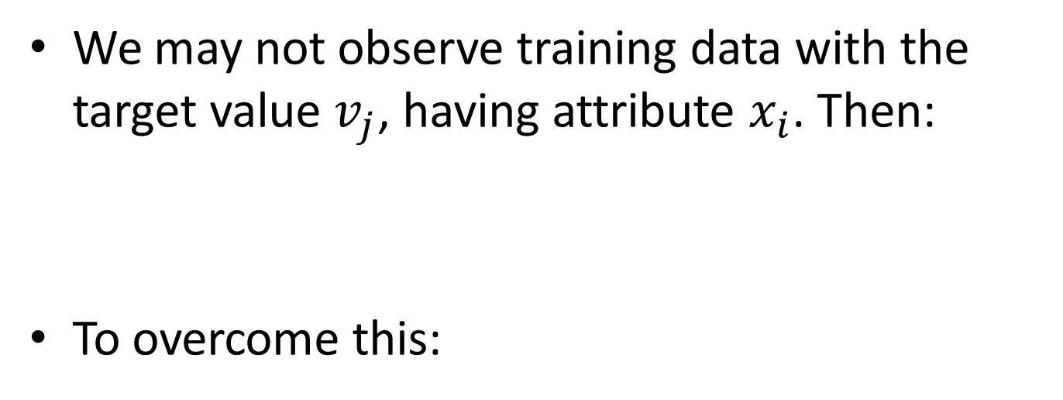
Notes of caution! (2)
We may not observe training data with the target value $v_{j}$, having attribute $x_{i}$. Then:
To overcome this:
nc is the number of examples where v = v_j and x = x_i
m is weight given to prior (e.g, no. of virtual examples)
p is the prior estimate
n is total number of training examples where v=v_j

Slide 6
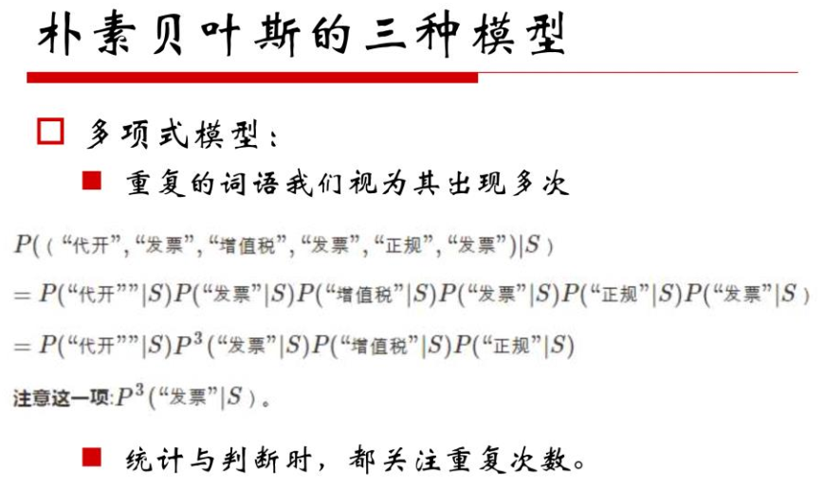

Slide 7
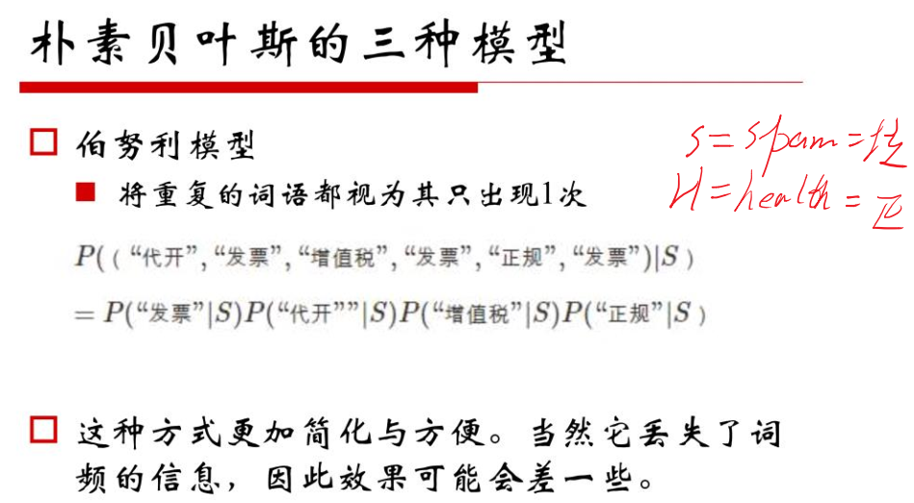

Slide 8
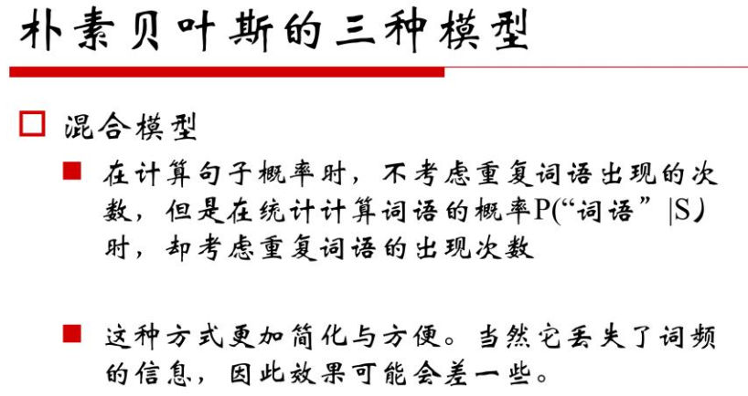

Slide 9
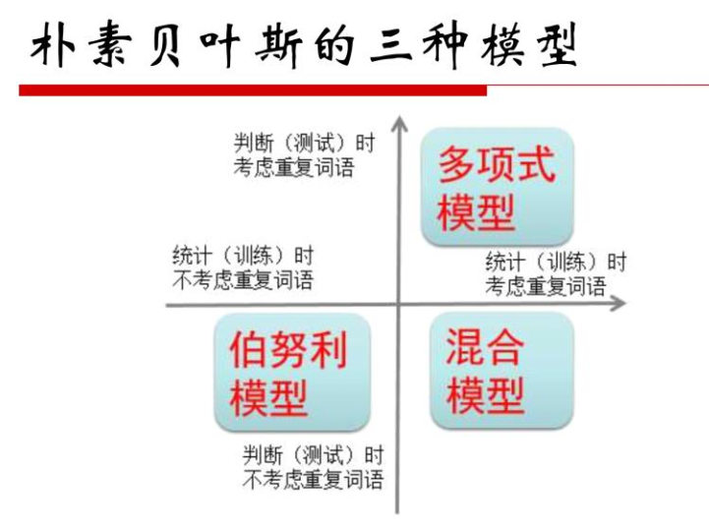

Slide 10
Clustering

Slide 11
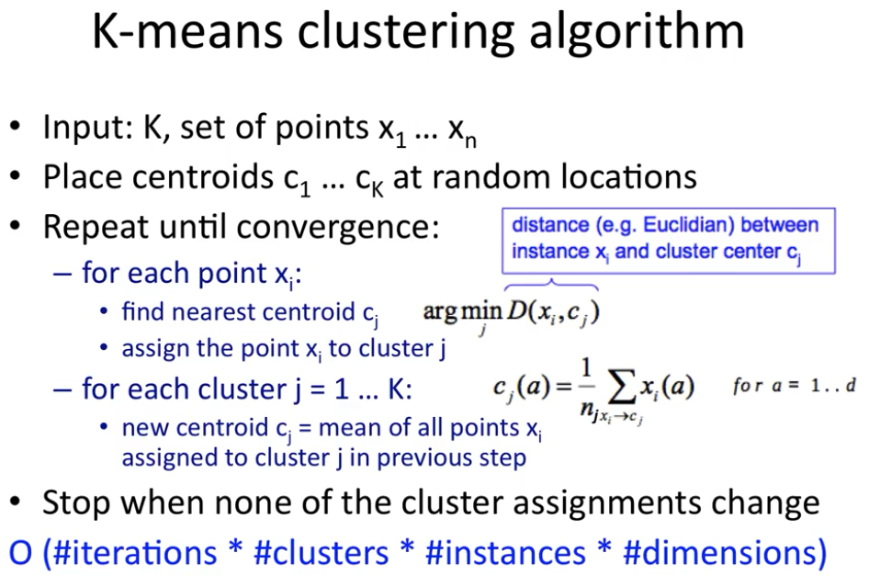

Slide 12
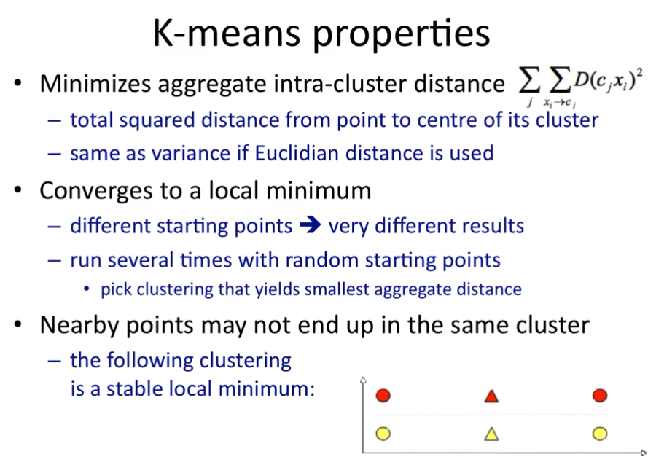

Slide 13
Hierarchical Clustering

Slide 14
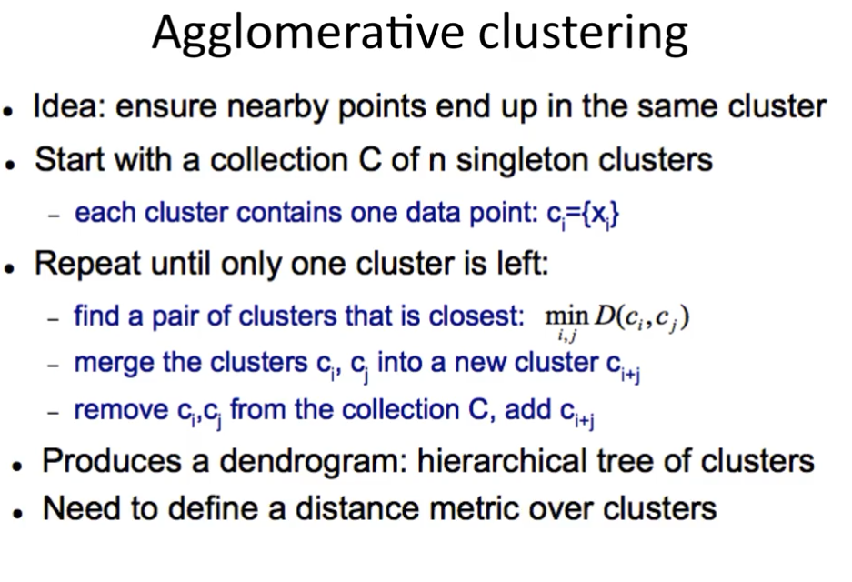
Notes:
dendrogram
英 ['dendrəgræm] 美 ['dendrəgræm]
n. 系统树图（一种表示亲缘关系的树状图解）

Slide 15
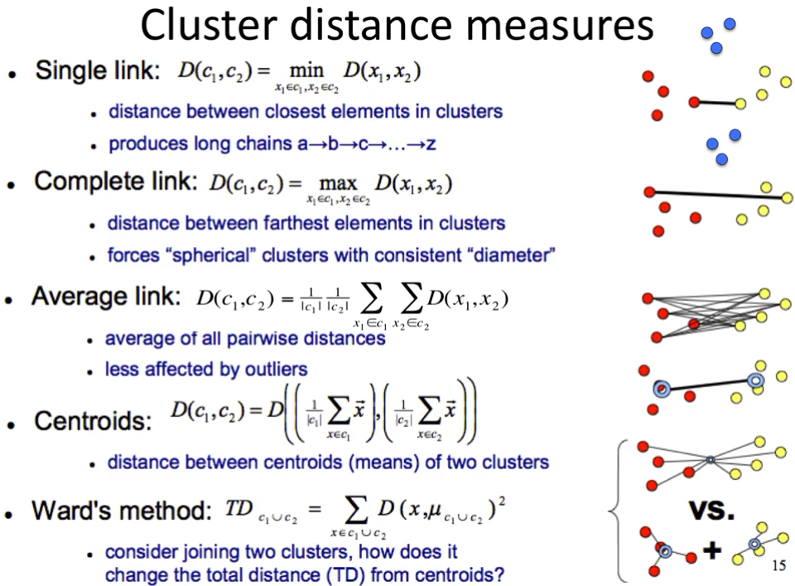

Slide 16
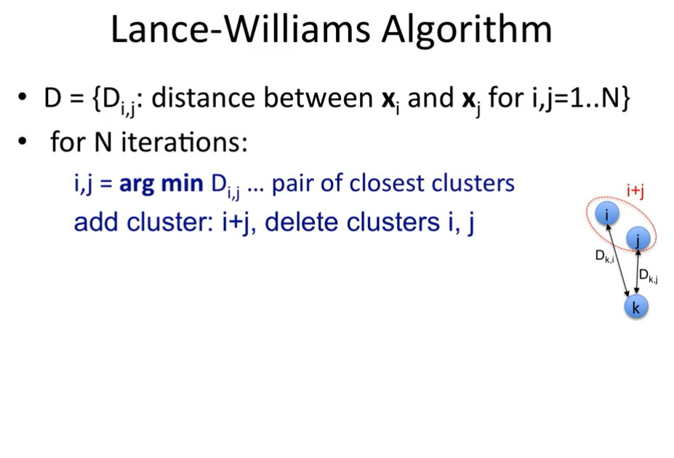

Slide 17
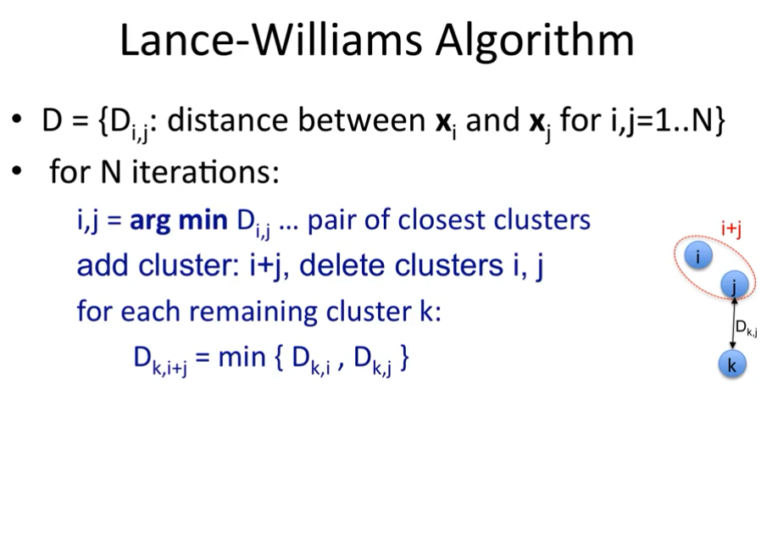

Slide 18
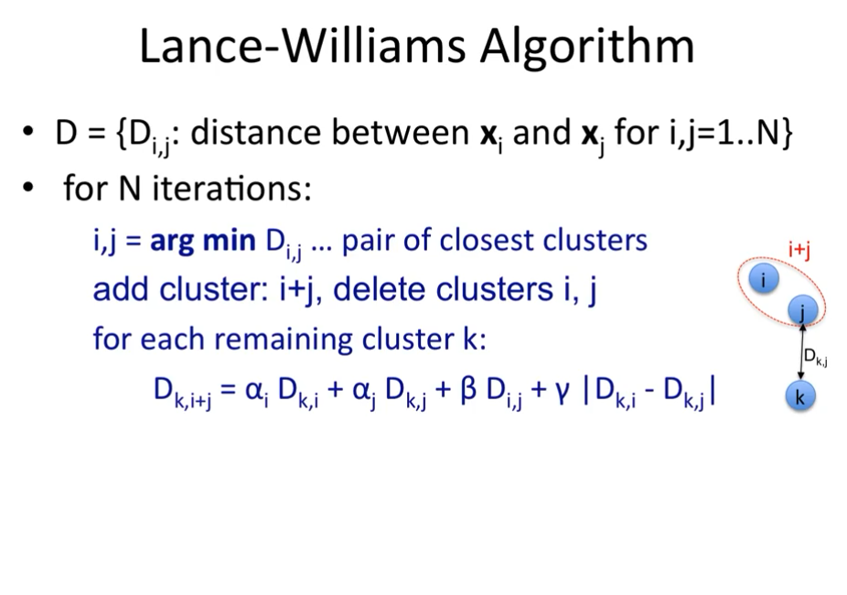

Slide 19
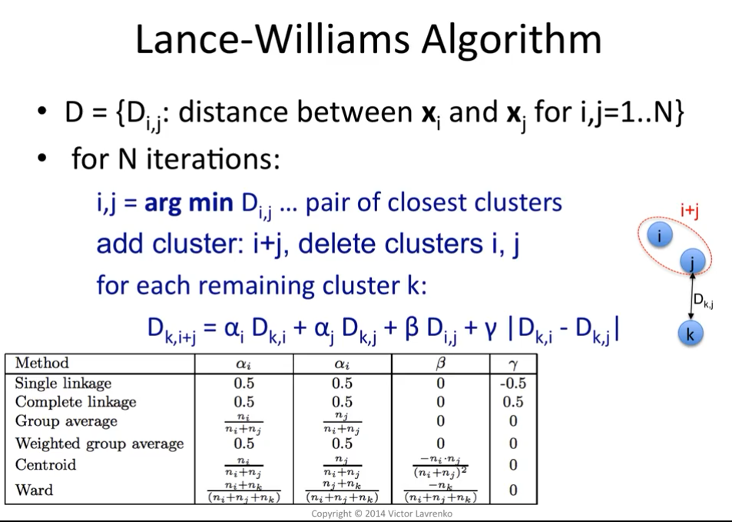
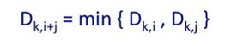

Slide 20
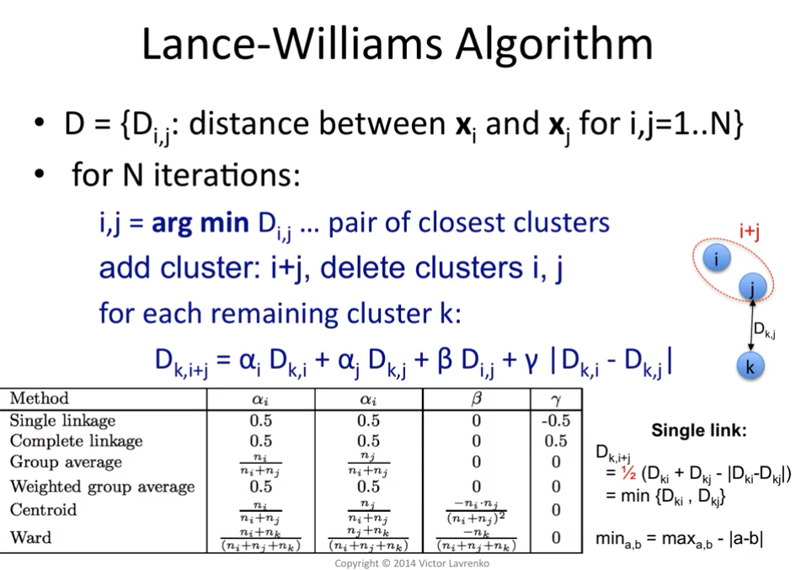

Slide 21
Density-based Clustering

Slide 22
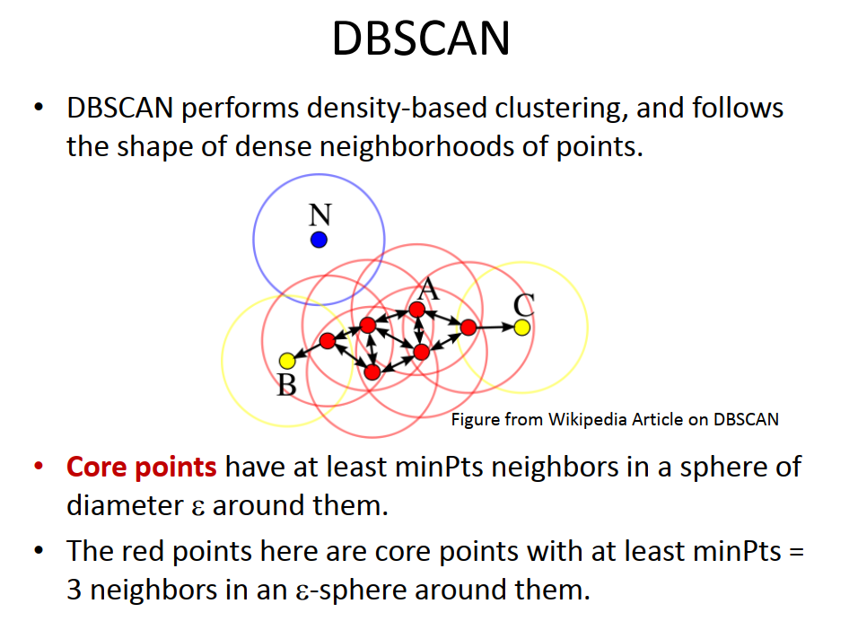

Slide 23
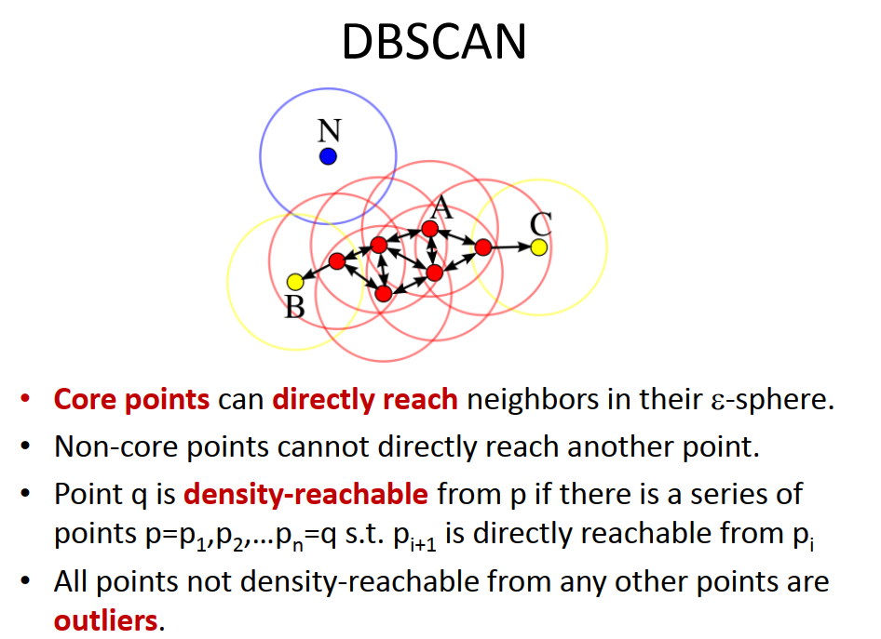

Slide 24
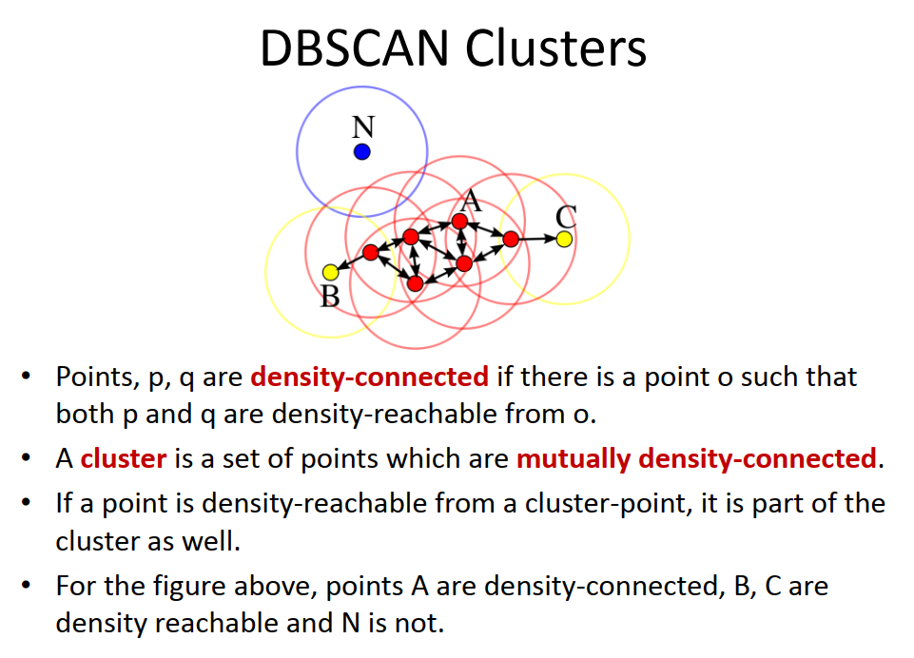

Slide 25
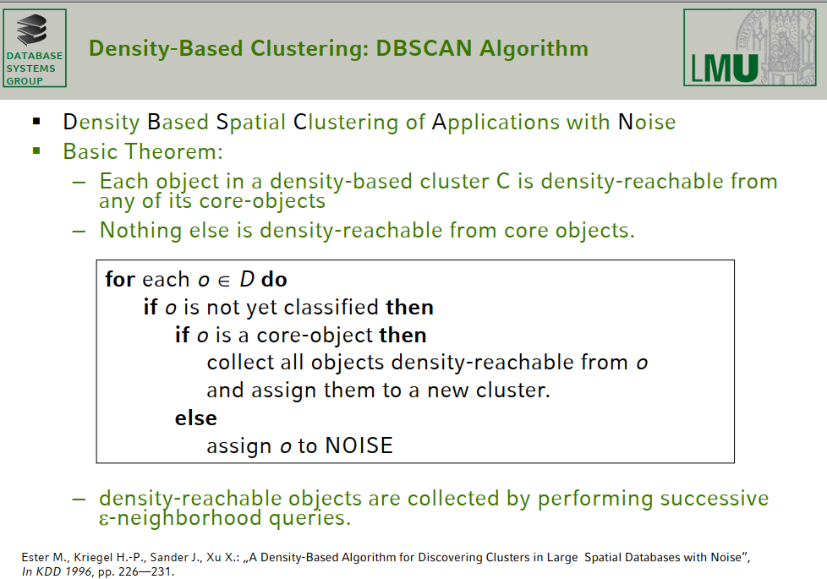
Notes:
SIGKDD2014

Slide 26
DBSCAN Algorithm
The DBSCAN algorithm can be abstracted into the following steps:
Find the points in the ε (eps) neighborhood of every point, and identify the core points with more than minPts neighbors.
Find the connected components of core points on the neighbor graph, ignoring all non-core points.
Assign each non-core point to a nearby cluster if the cluster is an ε (eps) neighbor, otherwise assign it to noise.
A naive implementation of this requires storing the neighborhoods in step 1, thus requiring substantial memory.
The original DBSCAN algorithm does not require this by performing these steps for one point at a time.

Slide 27
Mixture Models and the EM Algorithm

Slide 28
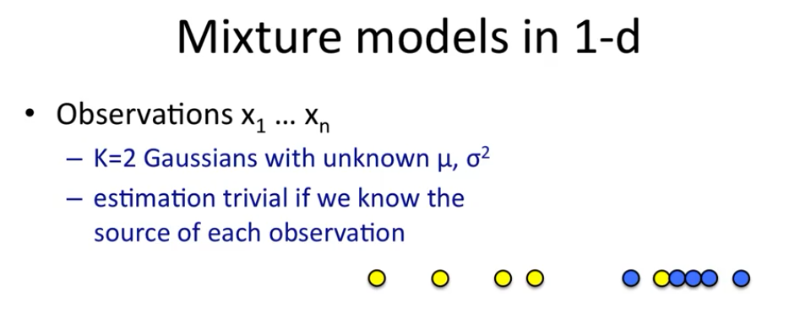

Slide 29
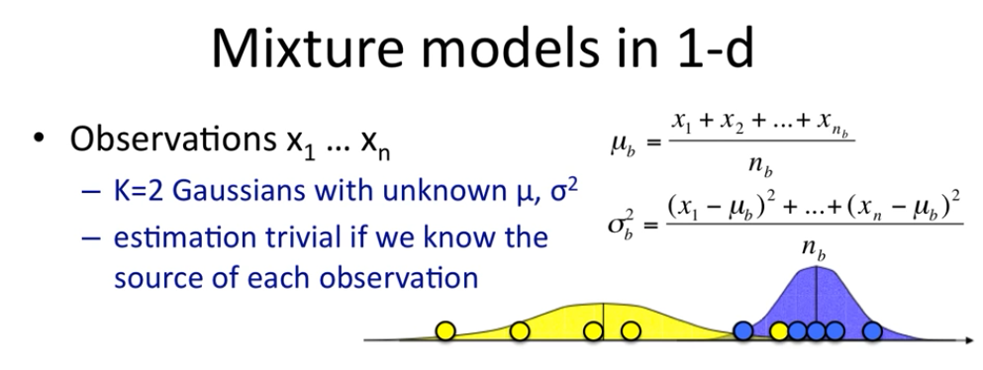

Slide 30
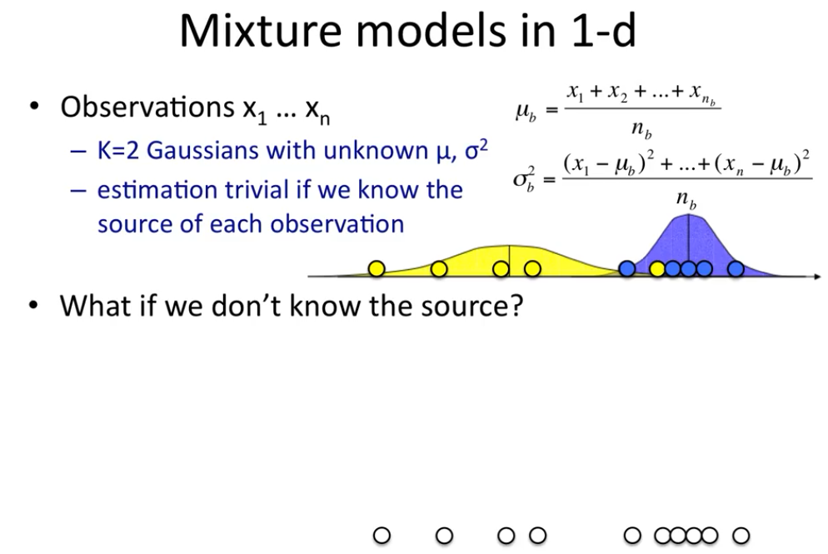

Slide 31
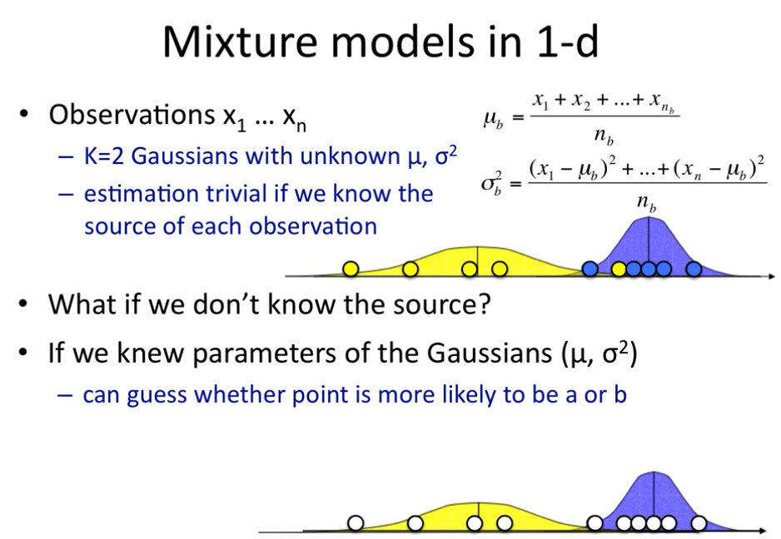

Slide 32
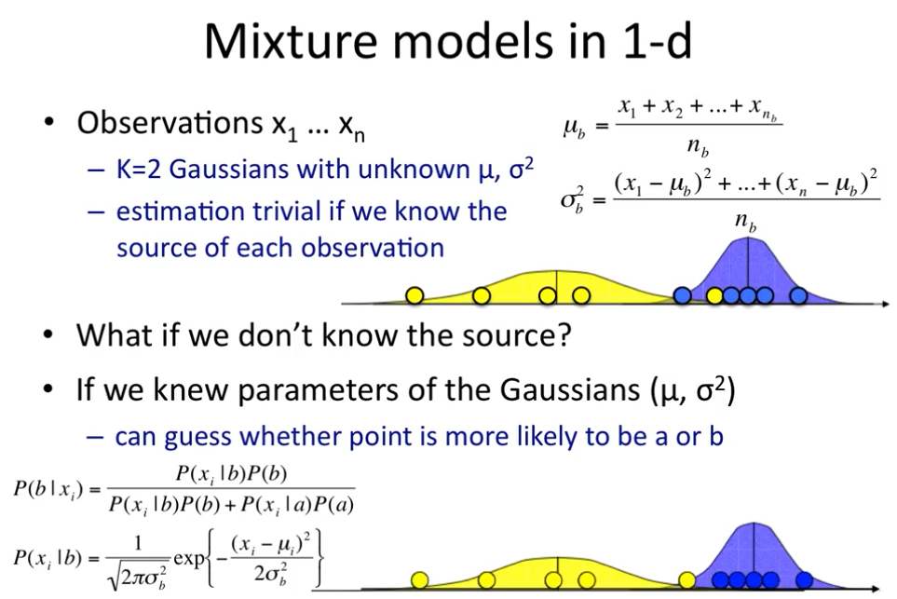

Slide 33
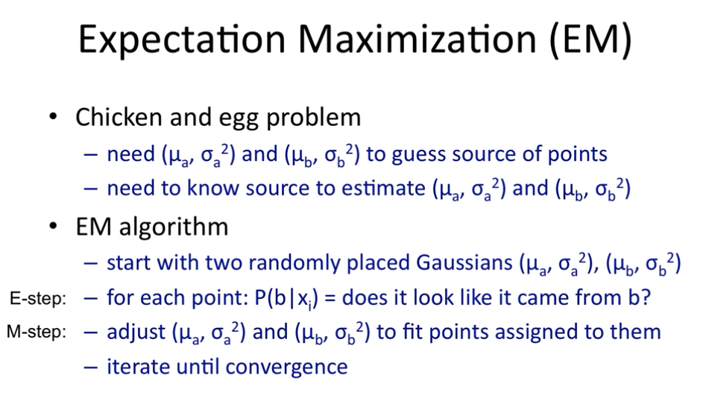

Slide 34
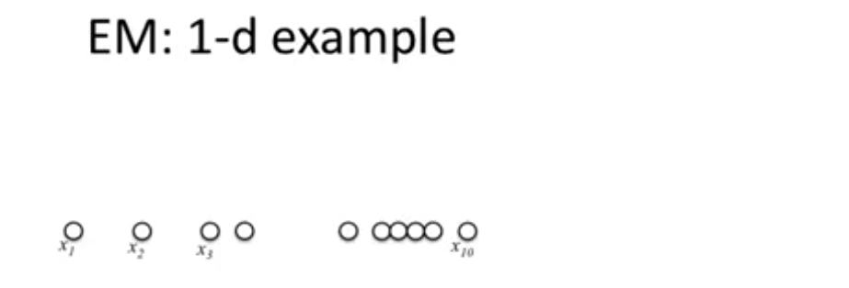

Slide 35
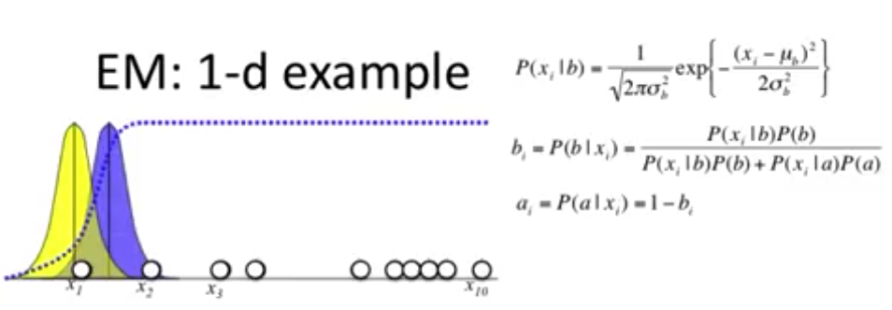

Slide 36
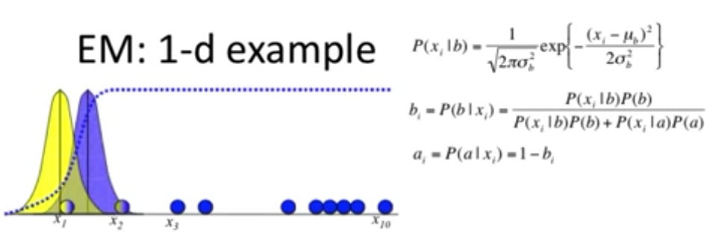

Slide 37
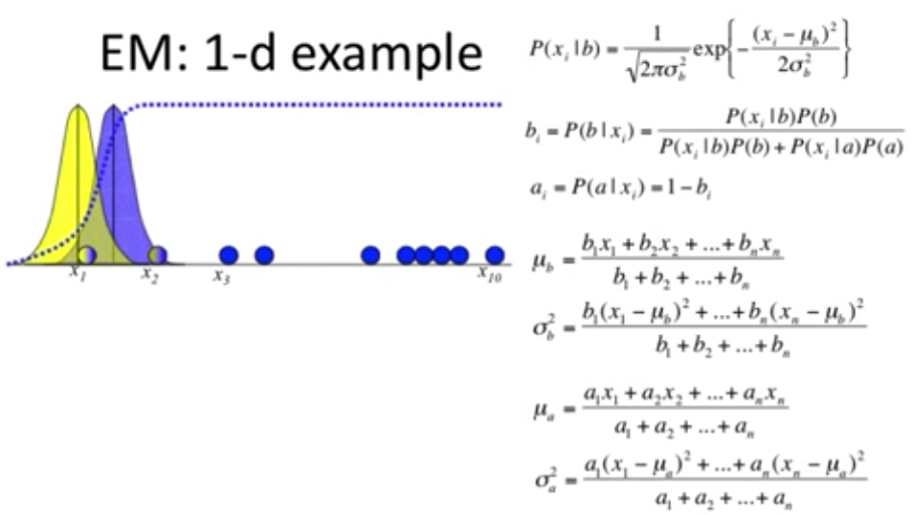

Slide 38
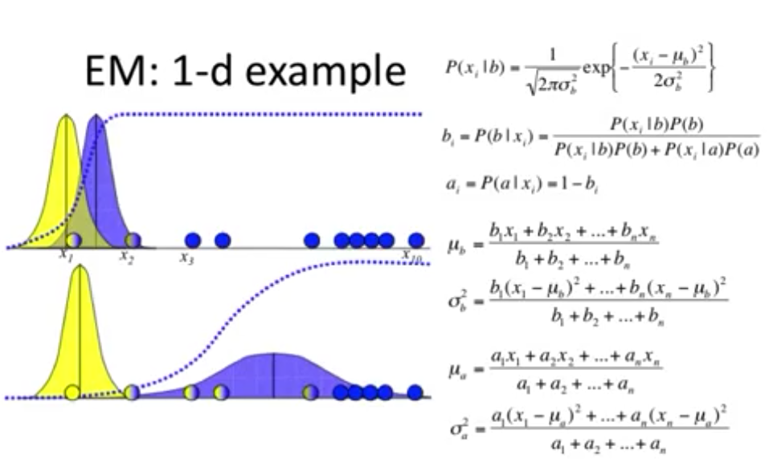

Slide 39
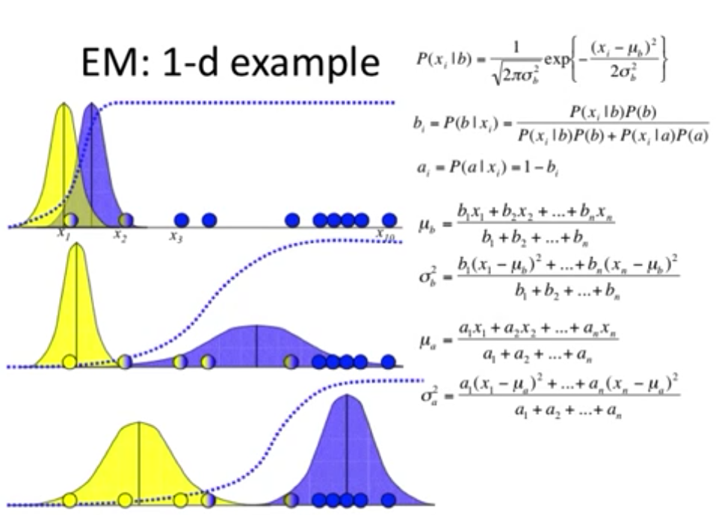

Slide 40
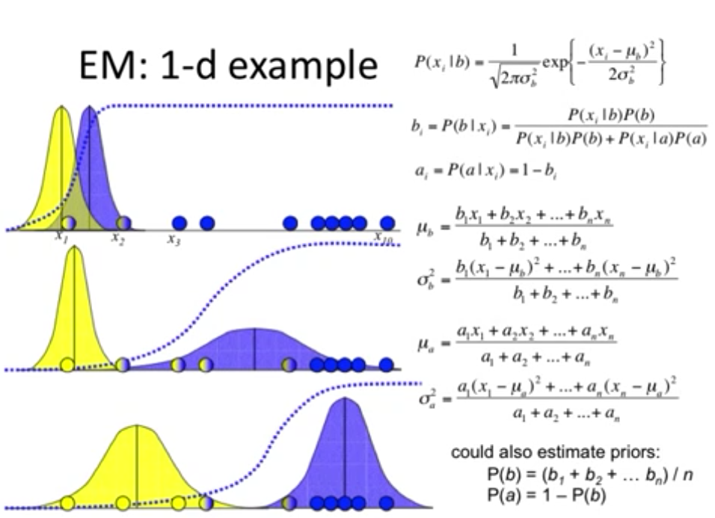

Slide 41
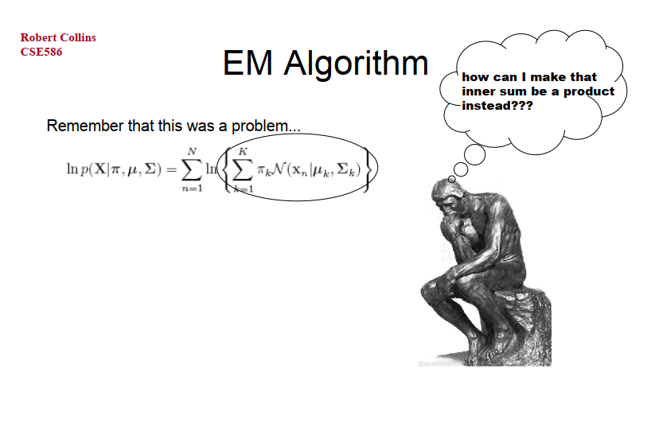

Slide 42
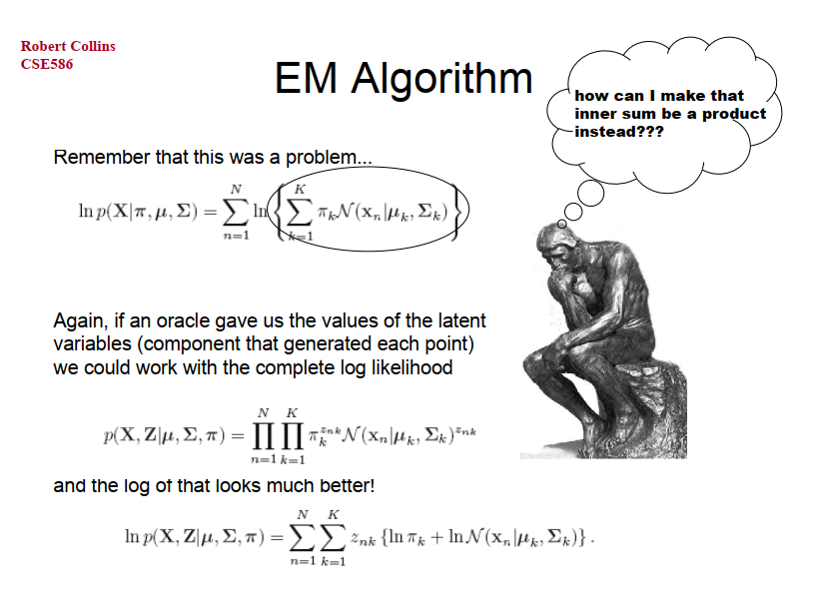

Slide 43
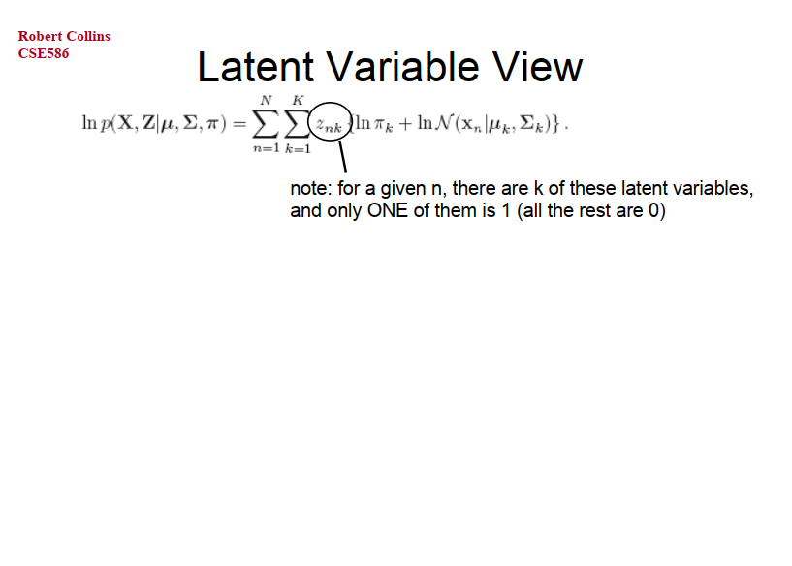

Slide 44
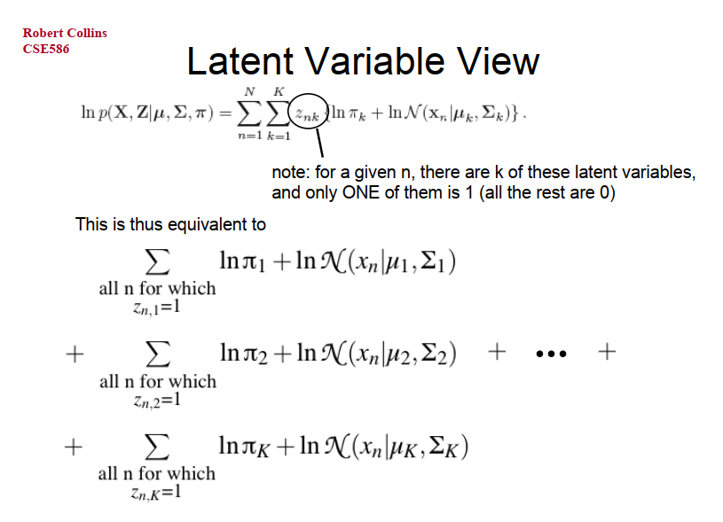

Slide 45
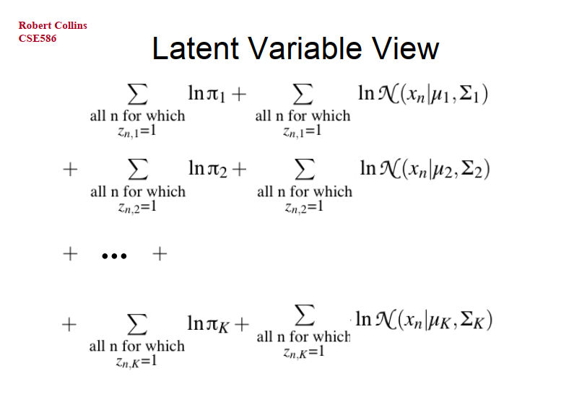

Slide 46
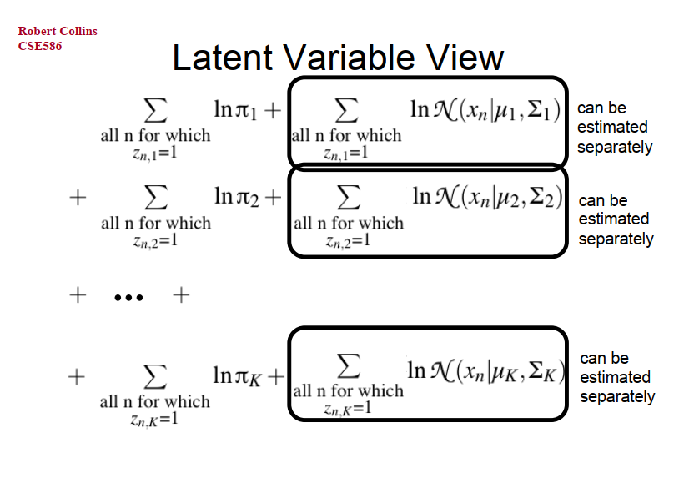

Slide 47
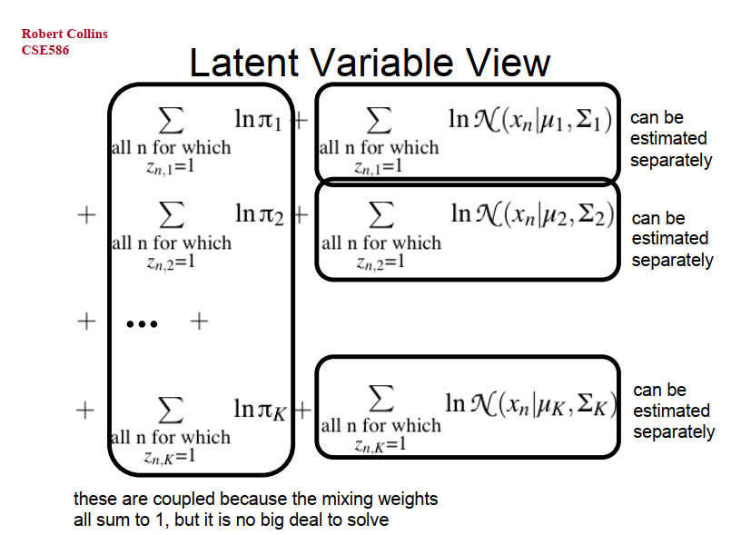

Slide 48
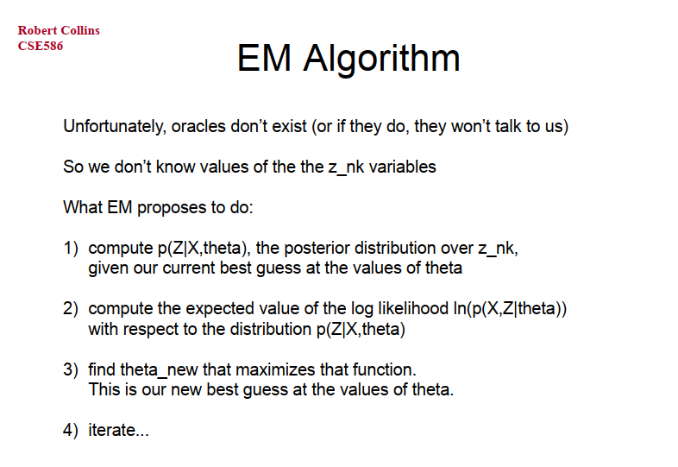

Slide 49
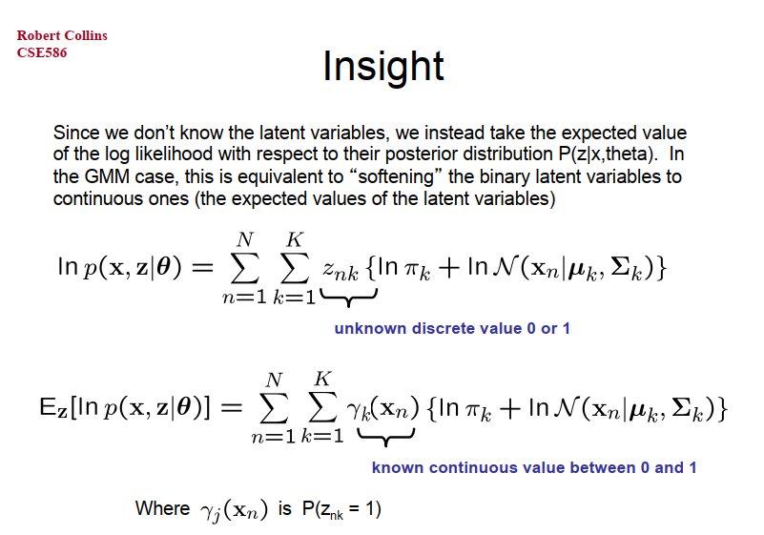

Slide 50
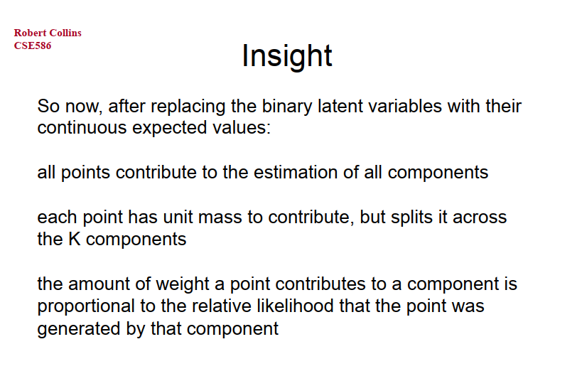

Slide 51
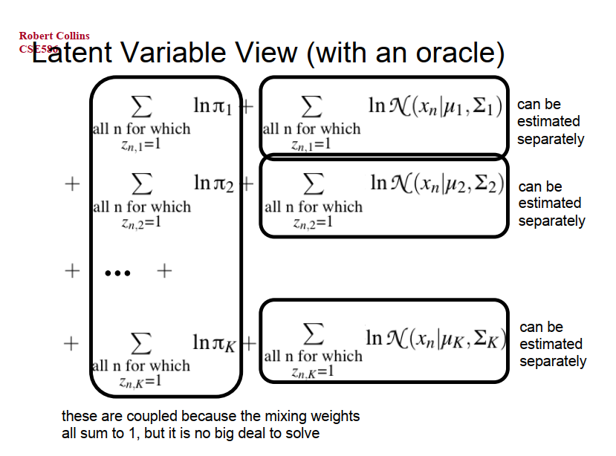

Slide 52
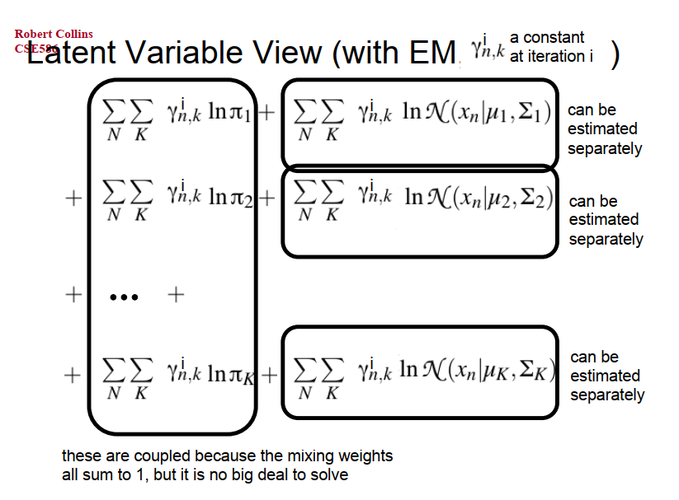

Slide 53
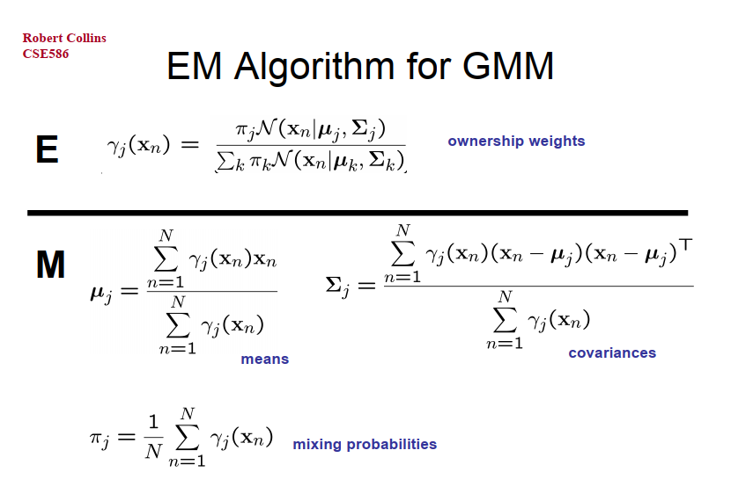

Slide 54
An Alternative View of EM

Slide 55
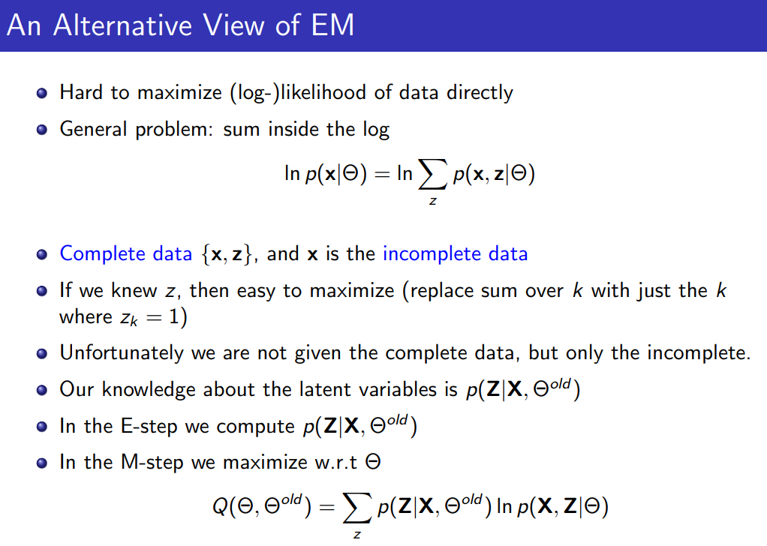

Slide 56


Slide 57



Tips:

Slide 58


Slide 59


Slide 60


Slide 61


Slide 62


